Slide 1

Next Best Action
Case study

Slide 2
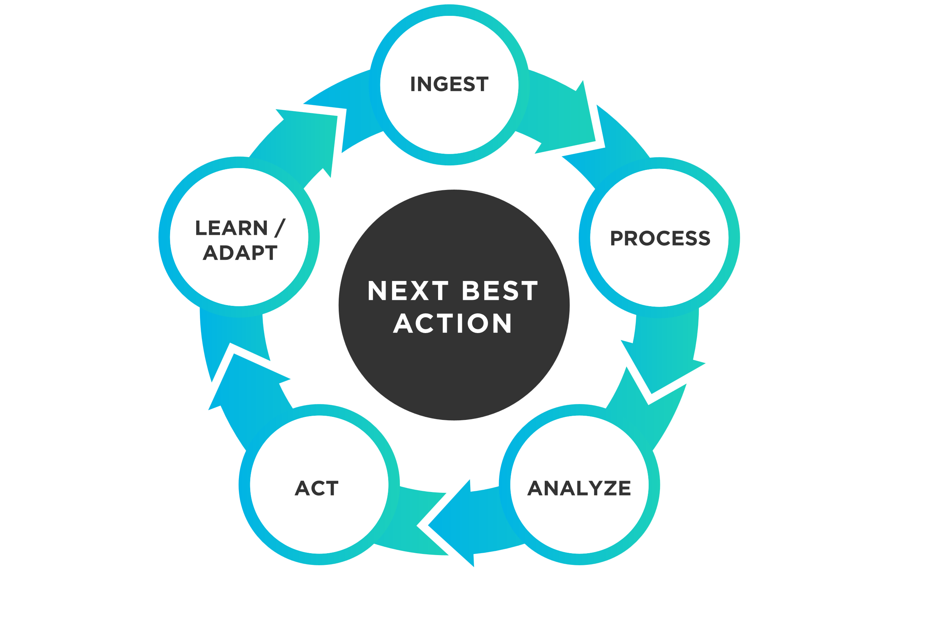
Understanding and application
Next Best Action is a predictive analytics which generates the output based on user personalization.
For Contlo we are going to employ NBA method to increase the interactions based on customer behaviors, preferences and history.
Based on the customer interactions our model adapts and evolves as a response to customer’s change in behavior.

Slide 3
STRATEGY FOR INTEGRATION
PREDICTIVE MODELING
PERSONALIZATION TECHNIQUES
DATA-DRIVEN DECISION MAKING
EXPECTED IMPACT

Slide 4

TECHNOLOGY REQUIREMENTS
MACHINE LEARNING ALGORITHMS
AI ANALYTIC TOOLS
INFRASTRUCTURE ALGORITHMS

Slide 5
SCALABILITY AND PERSONALIZATION
Cloud base Infrastructure
Automated Workflows
Dynamic Content Generation
Human Interaction

Slide 6
Measurement Of Success
User engagement rates
Click through rate on recommendations
Revenue impact

Slide 7
THANK YOU!

